Slide 1
Lending Club Case Study
By Abhinav Swarup & Srikaran R
Git : https://github.com/abhinavswarupgit/Lending-Case-Study-Upgrad-

Slide 2
Problem Statement
Business Understanding
Lending Club is the largest online loan marketplace, facilitating personal loans, business loans, and financing of medical procedures
There are two types of risks associated.
Not approving the loan to credible customers results in business loss
Approving loan to defaulters also contributes to business loss
Business Objectives
Provide recommendations to identify customers who are likely to default
Use the approved loan data to create patterns and support the recommendations
Solution Strategy
Use Exploratory Data Analysis
Identify Patterns
Provide recommendations on top risk factors for loan approval process

Slide 3
Solution Approach
Data Preparation
Source and load data obtained
Clean data for Null/0 values
Data Selection
Univariate Analysis
Remove/Impute columns containing blank/irrelevant data
Create additional categorical variables
Create a correlation matrix to identify positive and negative relations
Identify a list of features based on the correlation and domain knowledge , for analysis
Create box plot to analyze the distribution of selected variables
Identify loan default percentages with the selected features
Create distplot to find the frequencies of the selected features
Create point plot for categorical variables
Bivariate Analysis
Use pairplots to identify correlation between the chosen features
Use line plots between features to identify correlation

Slide 4
Assumptions & Business Constraints
Loan Status is the Target Variable for the current analysis, and we will be dropping the records containing values as ‘Current’ as we cannot infer whether the applicant will default or pay the entire loan amount back
Features containing more than 50% of null values are dropped
Features having same values for all records and unique values for all records are dropped
Highly correlated features are dropped
Features Employee length and Number of public record bankruptcies are imputed to their mode values
Features reflecting customer behavior variables that are not available at the time of application of loan are not considered for analysis
Features like interest rates and employee length are standardized for better analysis
Critical numerical features are categorized for segmented analysis
For the feature annual income, couple of outlier values are dropped as they did not have any impact on the analysis

Slide 5
Feature Selection
Based on the correlation matrix and business knowledge, The following features were selected for analysis
Loan Amount
Interest Rate
Term
Annual Income
Loan Grade
Debt to Income Ratio
Loan Purpose
Revolving Utilization of Credit
Employee Length
Public Rec Bankruptcies

Slide 6
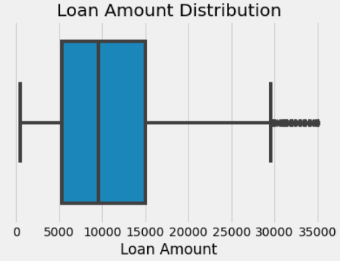
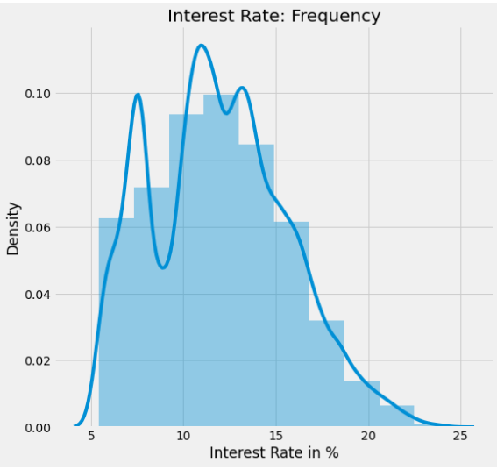
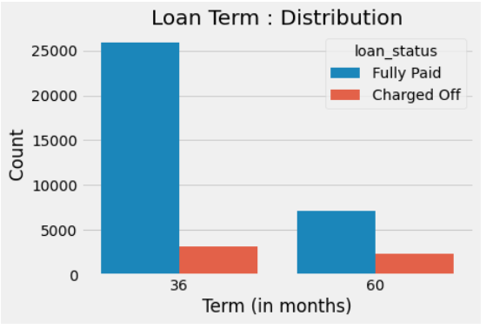
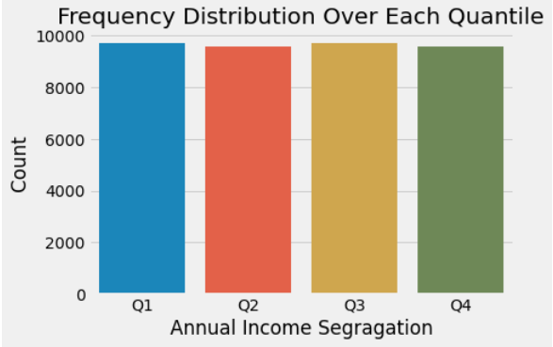
Univariate Analysis
Loan Amount
Interest Rate
Most loans are given between $5000 and $15000
Most Loans are given on the interest rate of 9% to 14%
Term
Annual Income
Most loans are taken for 36 months
The income are equally distributed across the category

Slide 7
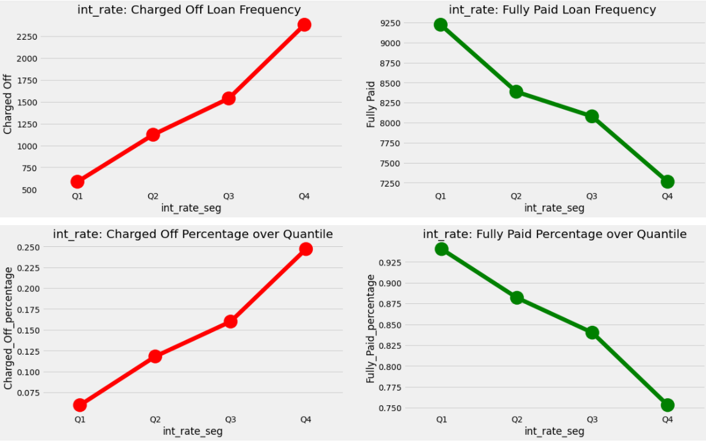
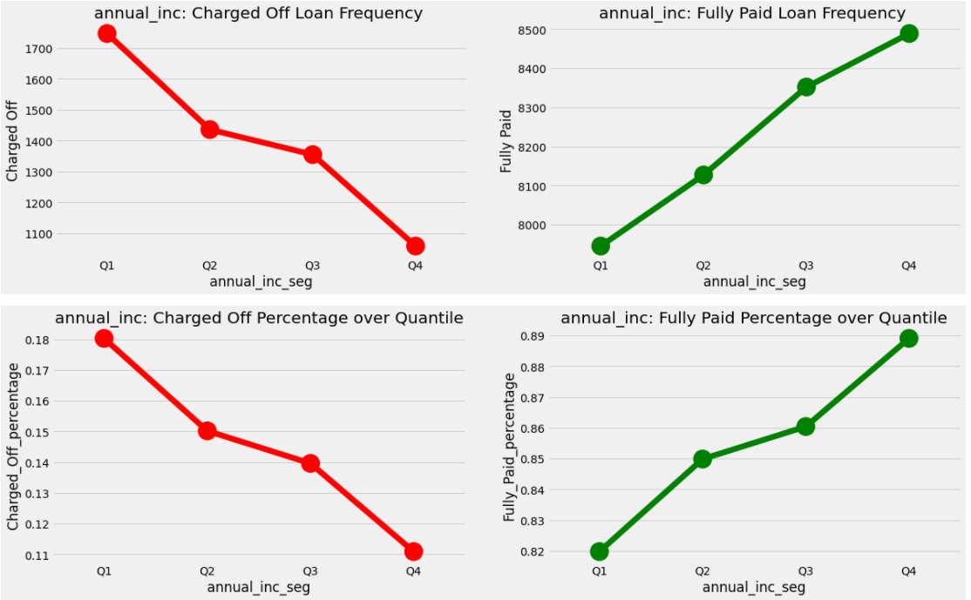
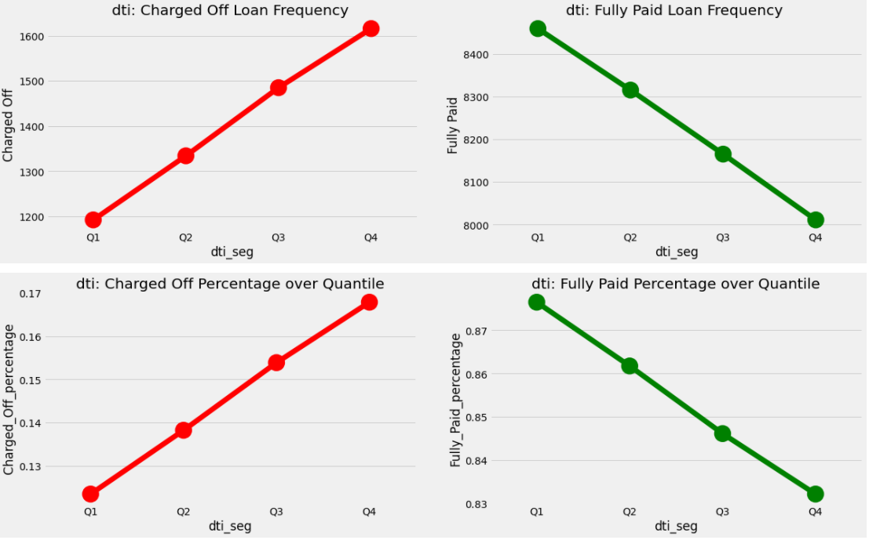
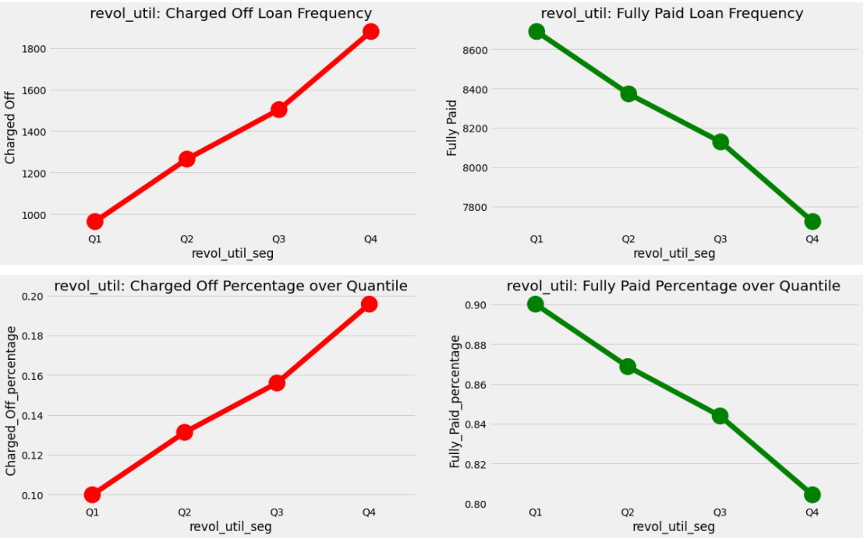
Segmented Univariate Analysis
Loan status is plotted against different categories of selected Features
The below features with high values show a higher correlation to charged off loans except for Annual Income which has a negative correlations
Interest Rate
Annual Income
DTI
Revolving Utilization of Credit

Slide 8
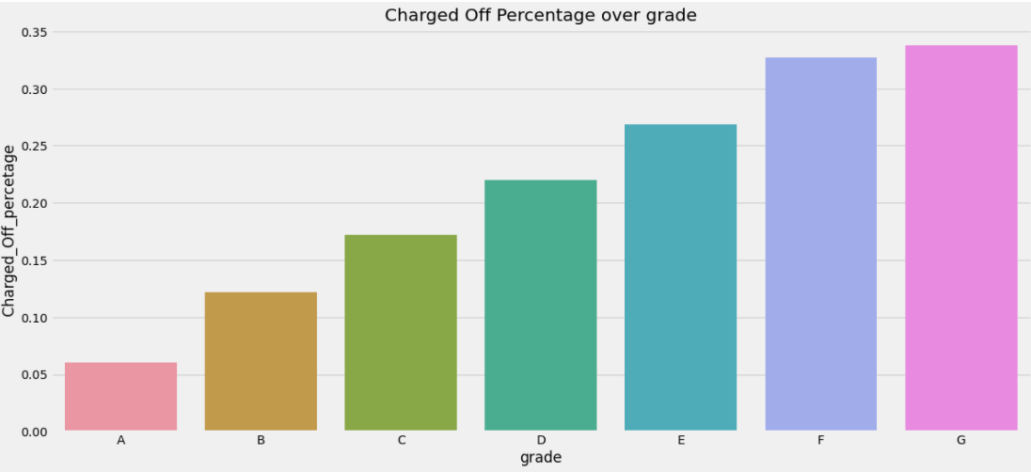
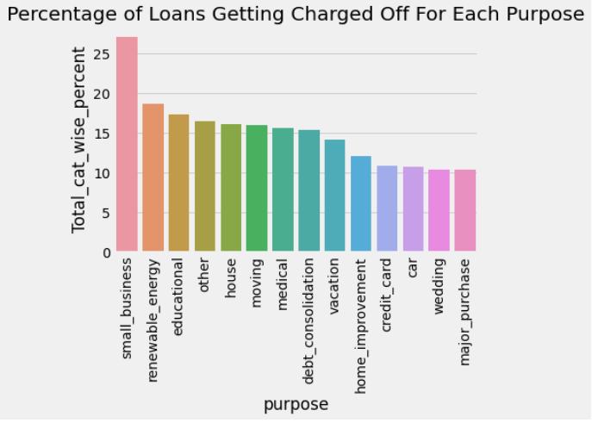
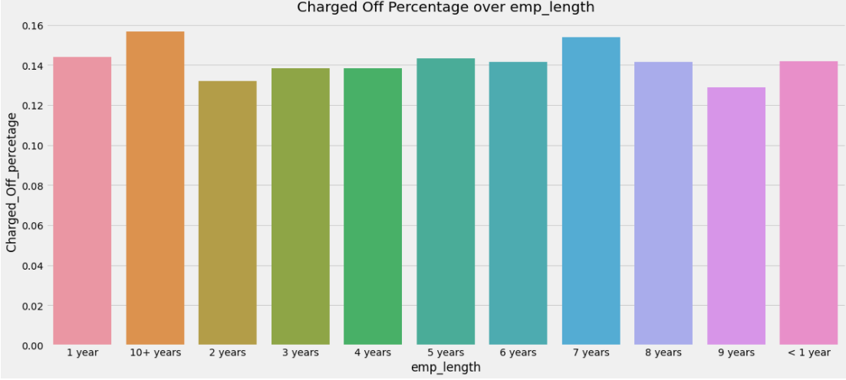
Segmented Univariate Analysis
Risk factor increases when we move from Loan Grade A to G
There is no direct impact of number of years of job experience on loan charged off
Small business is more riskier compared to other purpose of loans
Loan Grade
Purpose
Employee Length

Slide 9
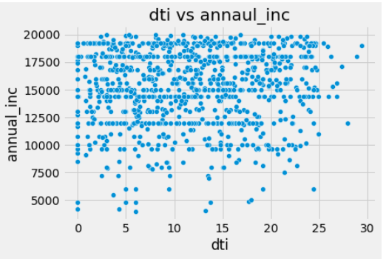
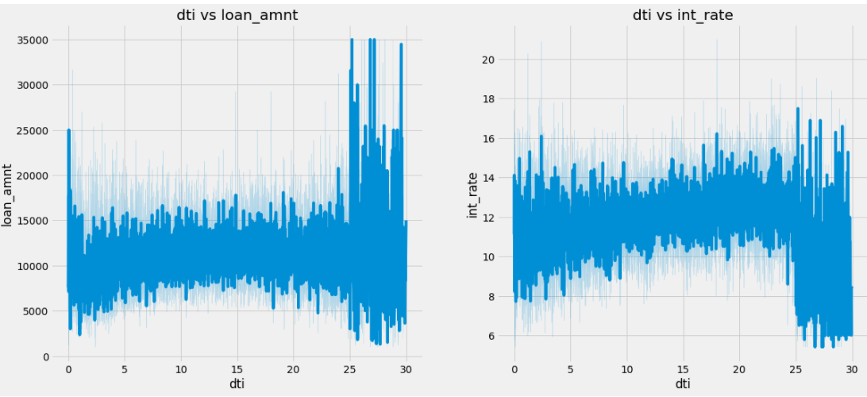
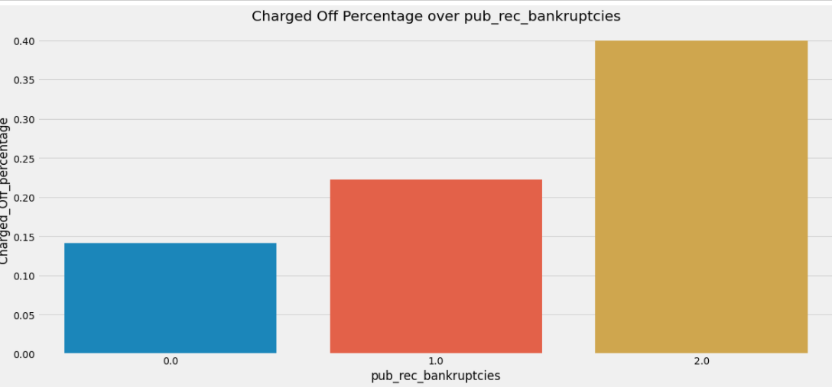
Bivariate Analysis
Scatter plot and Line plots are prepared against the selected features to identify correlation
DTI vs Annual Income has less significance where else loan amount is spread with DTI and Interest rate are low too
Applicants having public bankruptcies are defaulters

Slide 10
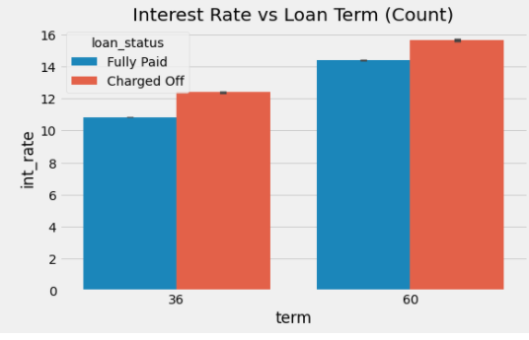
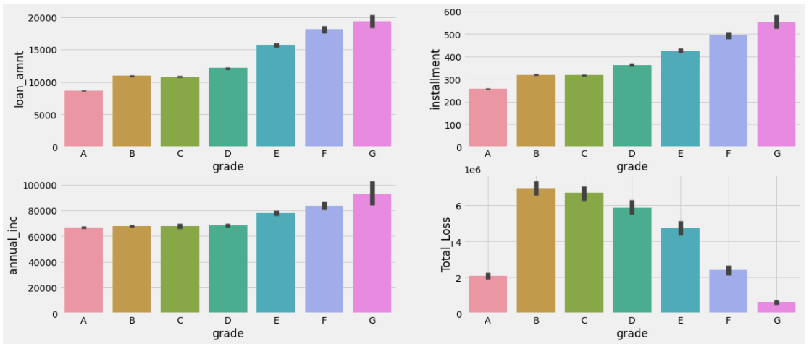
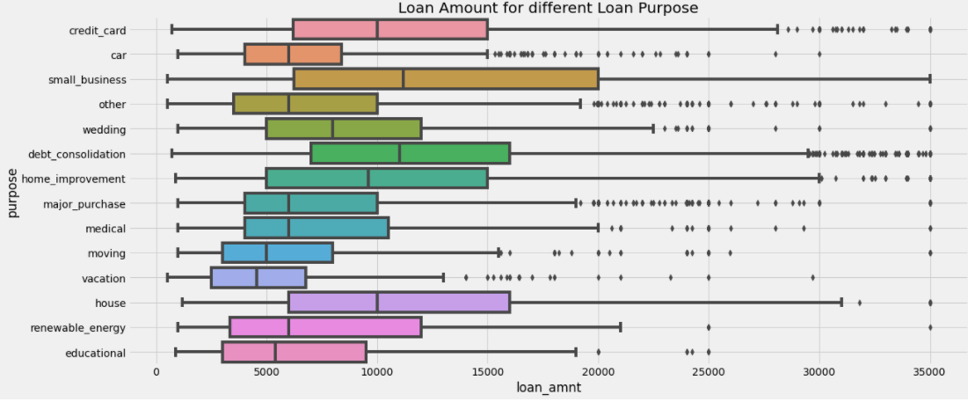
Bivariate Analysis
Grade G are given for high income applicants and for high loan amounts and higher installments
60 months loans are given at higher interest rate
Higher amount of loan are taken for small business and debt consolidations

Slide 11
Recommendations
Based on the Exploratory Data Analysis performed, the following are the recommendations which are the driving factors in deciding the loan risk levels
Higher Debt to Income ratios corresponds to more defaulting
Small Business tends to be more risker Purpose compared to others
Loan Grades F & G are more riskier when combined with higher interest rates
Applicants with Public Record of Bankruptcies are sure to default
Applicants with higher Annual Income are less riskier compared to lower income group
All the above features have to be looked together in determining the risky applicant and decision should not be taken based on one single feature mentioned

